Slide 1
Anomaly Detection in the CERN Proton Synchrotron RF Systems Using Machine Learning
Low Level rf conference 2025, Newport News, VA, USA
Acknowledgements: A. Lasheen, H. Damerau, B. Woolley, F. Velotti, M. Algelly, P. Ellison, PS-OP, SY-RF experts and piquet
Presenter: Joel Wulff
Date of presentation: 15/10/2025

Slide 2
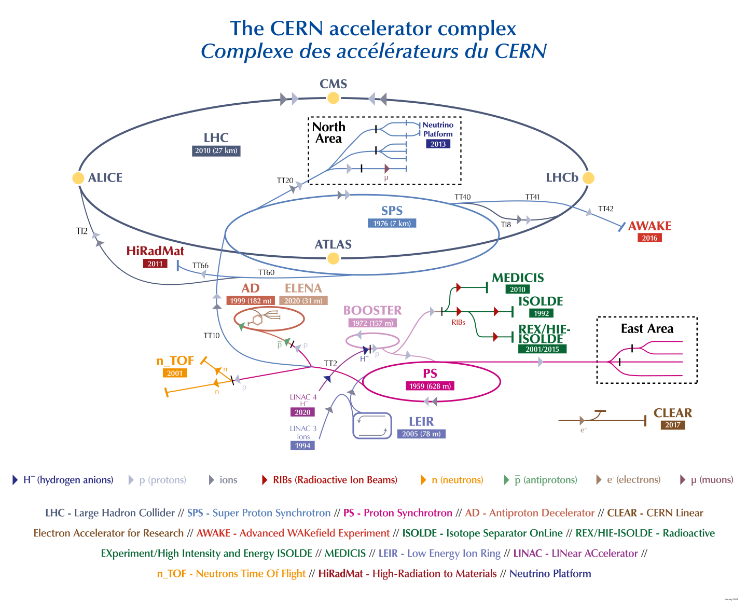
Introduction - The CERN PS
The CERN accelerator complex
A network of accelerators and experiments
The Proton Synchrotron: one of the earliest accelerators in the chain

Slide 3
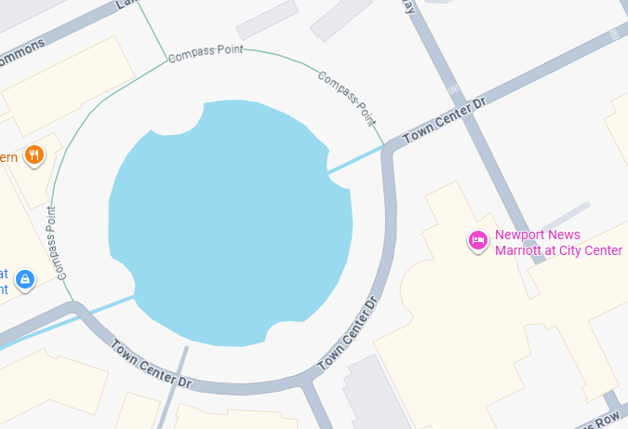
Introduction - The CERN PS
The CERN accelerator complex
A network of accelerators and experiments
The Proton Synchrotron: one of the earliest accelerators in the chain
Serves as both pre-injector to the LHC, and delivery accelerator to a large range of proton/ion experiments (with varied beam requirements).
PS
You are here!
Requires flexibility and extreme reliability
→Possible only with through excellent use and maintenance of its many RF systems!
Circumference ~ 1 Newport News lake

Slide 4
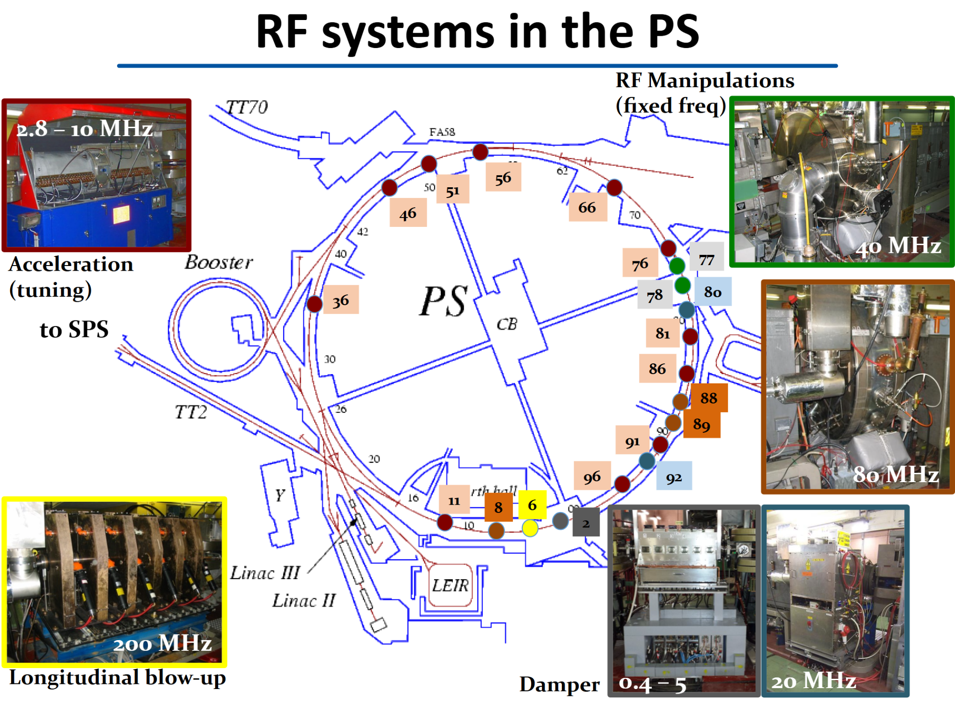
Introduction - PS RF systems
Wide range of:
RF frequency: from 2.8-200 MHz
Hardware/ages
→ Complicated to monitor, maintain, and diagnose…
Many potential sources of faults (meaning downtime)
Low-level RF
E.g, Feedback loop, Frontend computer faults, missing signals
External
E.g, B-train missing, Beam based, electrical glitch
High-level RF
E.g, Gap relay failures / early closures, Cavity tuning errors, amplifiers
To understand/prevent failure modes, need to understand root-causes.
→ Requires good diagnostics!
Figure from H. Damerau

Slide 5
Past experience
Constant efforts needed to keep the PS running at high availability (98%+ for RF)
Real time fault analysis often inefficient
Lack of tools for operators/RF experts to guide diagnostics, difficult to overview the whole accelerator and easy to feel overwhelmed.
Multiple calls when issues occur: to Low/High-level on-call personnel, equipment experts → High engagement of personnel!
Postmortem diagnostics and review become tedious and time-consuming
Information distributed, few links between tools
→ Extensive investigation by experts often necessary for finding root cause
How can we guide the investigation process, to know where to start, to become more efficient and proactive?
5

Slide 6
Towards proactive diagnostics
We need a solution/tool that is:
Capable of constantly monitoring systems → Warn early (ideally before fault?)
Generic→ a “recipe” that can scale to more than one type of equipment
Can correlate/monitor many systems → enable root-cause analysis
Idea: Exploit the large amount logged, measured signals and known settings to monitor the state of our systems, and provide a warning when things look not “normal”
Anomaly Detection

Slide 7
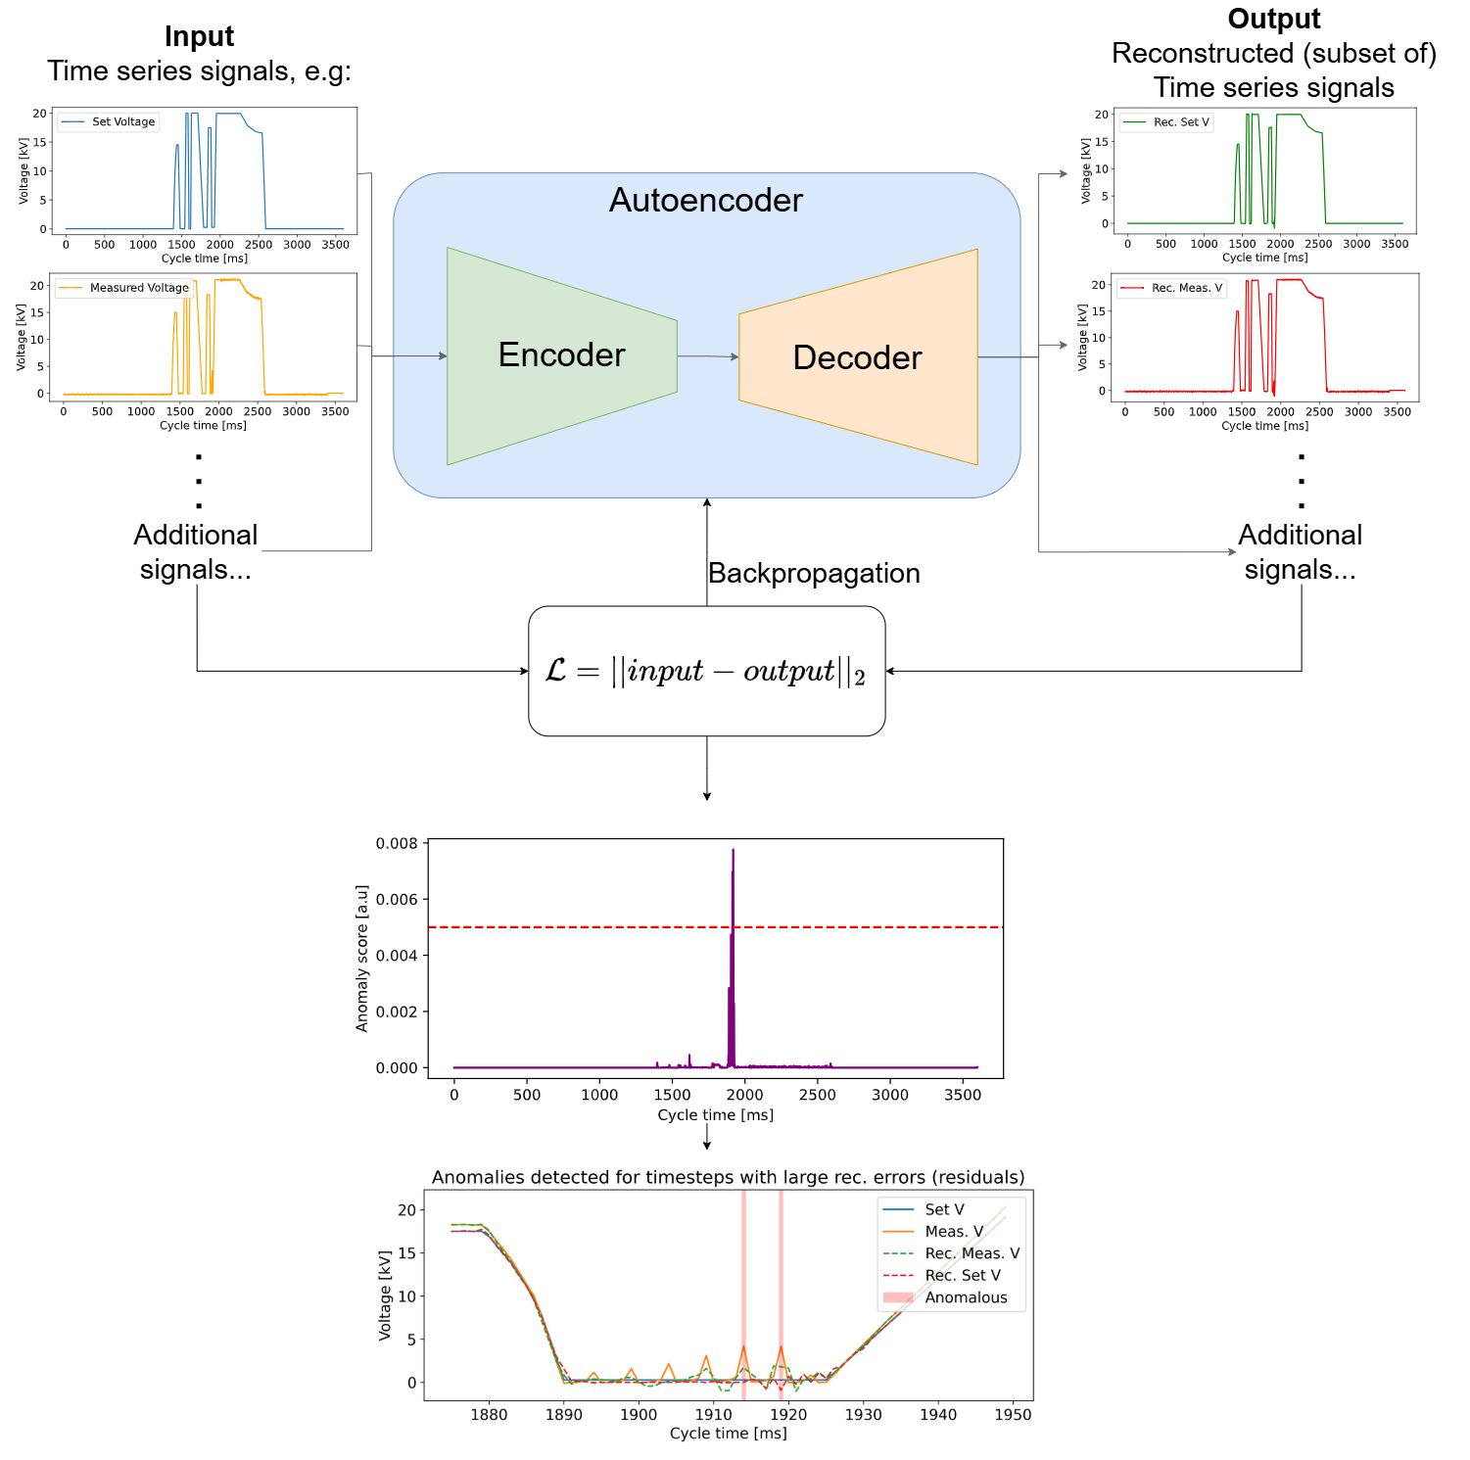
Reconstruction based Anomaly Detection (AD):
Auto Encoders
Basic idea: use in-distribution data (non-anomalous) to train an ML model
Normal signal
(Recon.) Normal signal
Learn to recon. well!
Train
Anomalous signal
(Recon.) Anomalous signal
Test
Backpropagation of unsupervised reconstruction loss.
Recons. poorly…
Similar methods explored for other systems at CERN: M. Algelly et. al. for KFA71 kicker

Slide 8
Reconstruction based AD: Auto Encoders
→ PS RF 10 MHz cavities
An anomaly threshold can be set (based on training data and testing on known anomalies).
Main RF system of the PS: 10 units (+1 spare)
Both programmed and measured voltages available
Autoencoder
+ Beam intensity!
Recon. loss
Timesteps with anomaly score above thresh. are flagged.
loss = Mean Square Error residual between inputs/outputs.
anomaly score calculated for each timestep using residuals.
Notes:
Explain why 10MHz is the obvious choice for pilot: 10 units, statistics, program and measured setting, main RF system

Slide 9
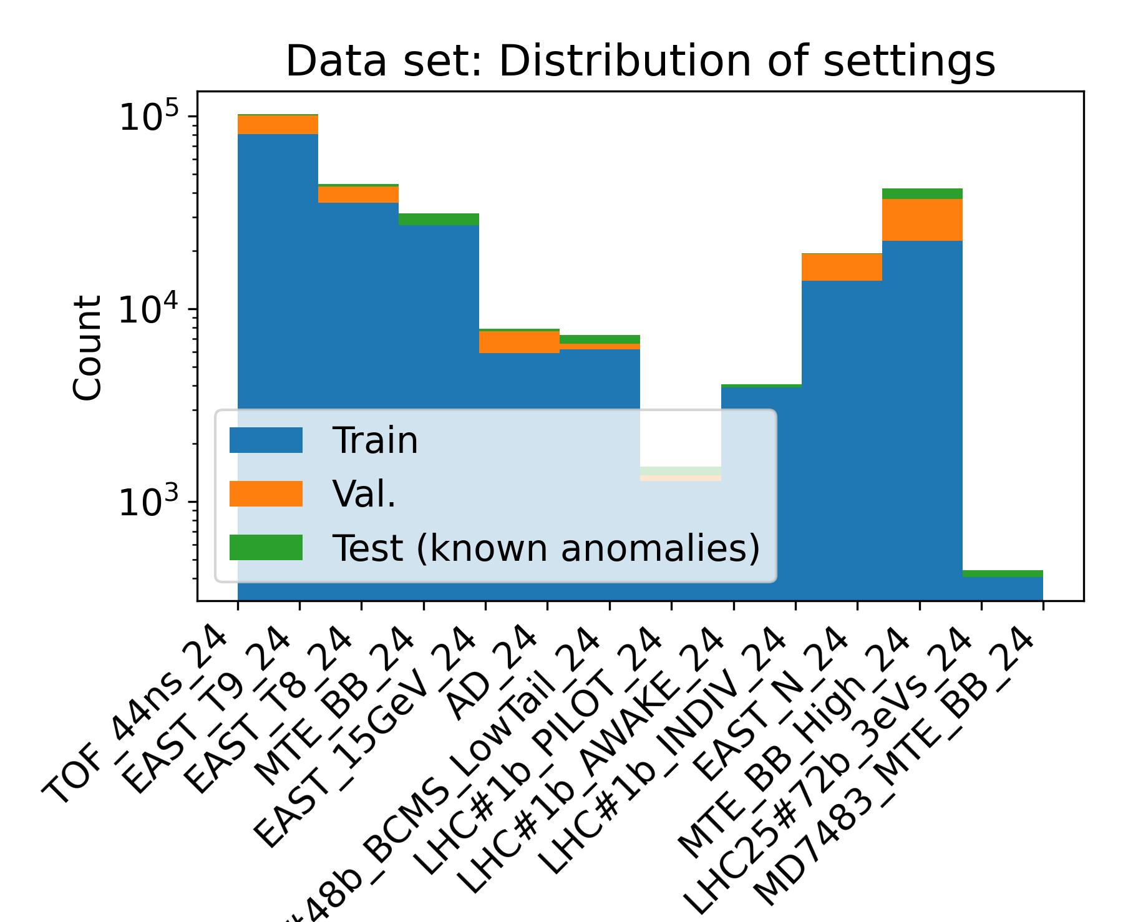
Collecting a dataset
Unsupervised logged data: no labels available for anomalous vs. non-anomalous samples…
Beam normally delivered well,
→ Assume anomaly rate << normal rate
→ Clean dataset of “obvious” anomalies
Max difference programmed vs. measured voltage
Total data:
From 3 weeks of PS Complex run (Sep. 2024)
→ ~260k PS cycles (after filtering of non-active and test cycles, missing historical settings…)
~13k suspected anomalous samples reserved for testing (filtered using max diff. prog. vs meas.)
Train/val. split 80/20 chronologically (all val. data acquired after training data)
N.B.: x-axis labels refer to different settings of the accelerator.

Slide 10
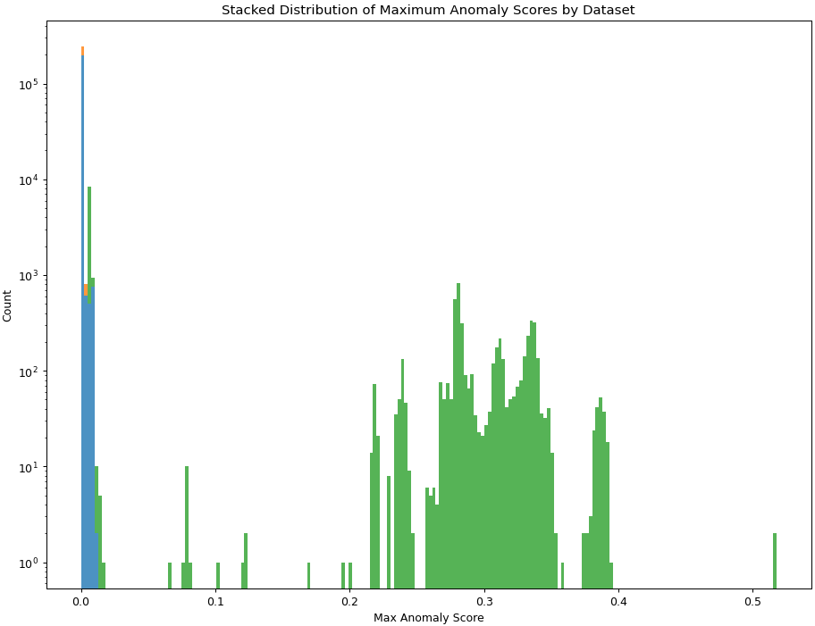
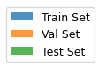
Training/Test results
Both training and validation sets have low anomaly scores! 😃
Cluster data as anomaly/normal based on anomaly score (here max., but could also use mean, etc.).
Most suspected anomalies reconstruct poorly 😃
With threshold, can separate data into normal/anomalous.
Clear distinction between most known anomalies and training!
Demonstrate and test in operation

Slide 11
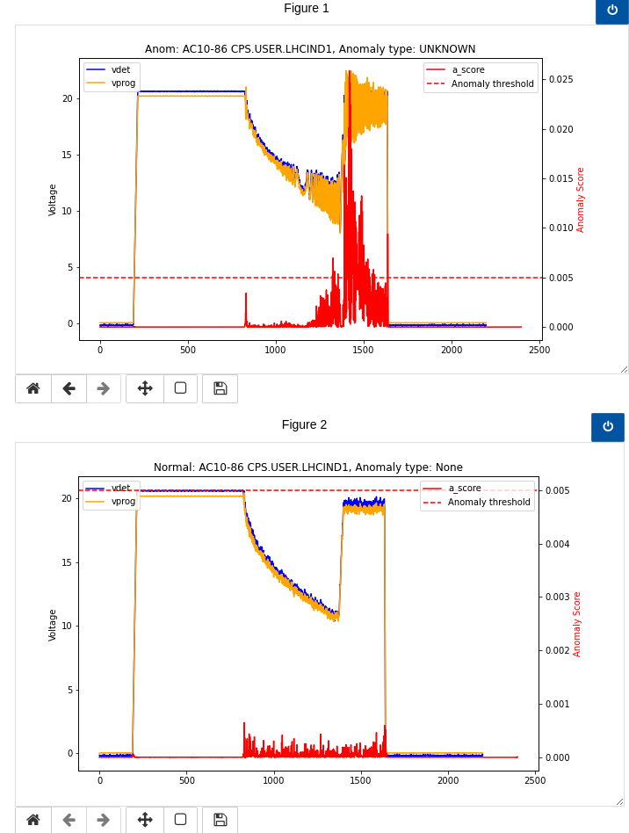
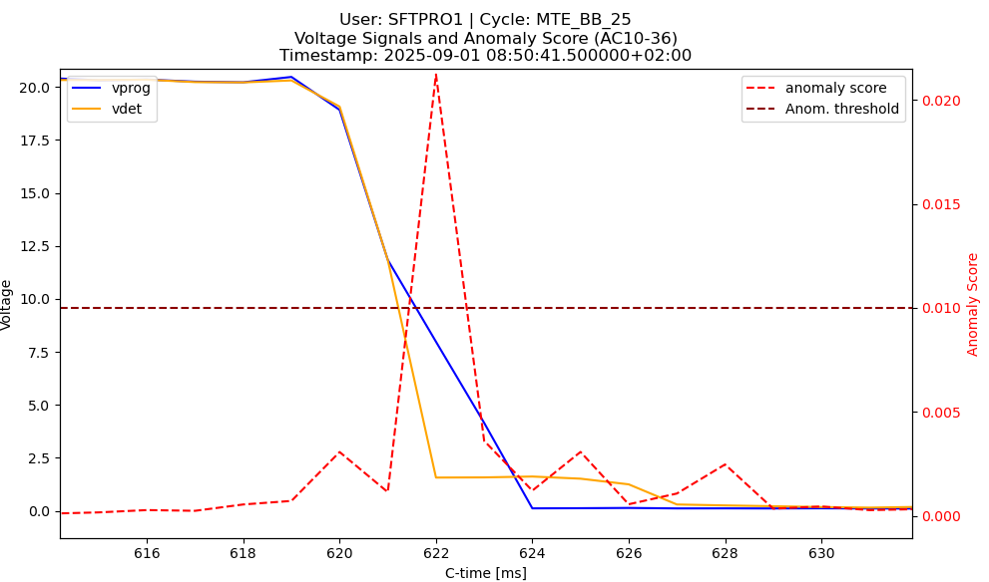
Demonstrated in operation - Real time anomaly detection
Normal
Trained on data from Sep. 2024
→Deployed on real-time data July 2025
Models remain valid: reconstruct “normal” events well
→ Already exploited in operation
Deployed live monitoring through web-based interfaces*
Shared with experts: very positive feedback!
Data logged → track statistical trends → forecasting?
Anomalous
Caught real anomalies
Oscillation damping failure
Early gap closure
→Corrected by expert!
See example in backup slides*

Slide 12
After 10 MHz pilot: what’s next?
Reconstruction-based A.D. successfully deployed for 10 MHz cavity voltages
First version of a “recipe” for anomaly detection on PS RF signals
→ can it be applied to more RF subsystems?
Apply to global beam loop signals!
Notes:
Simplify: Good results on 10 MHz, → expand to more subsystems of RF system

Slide 13
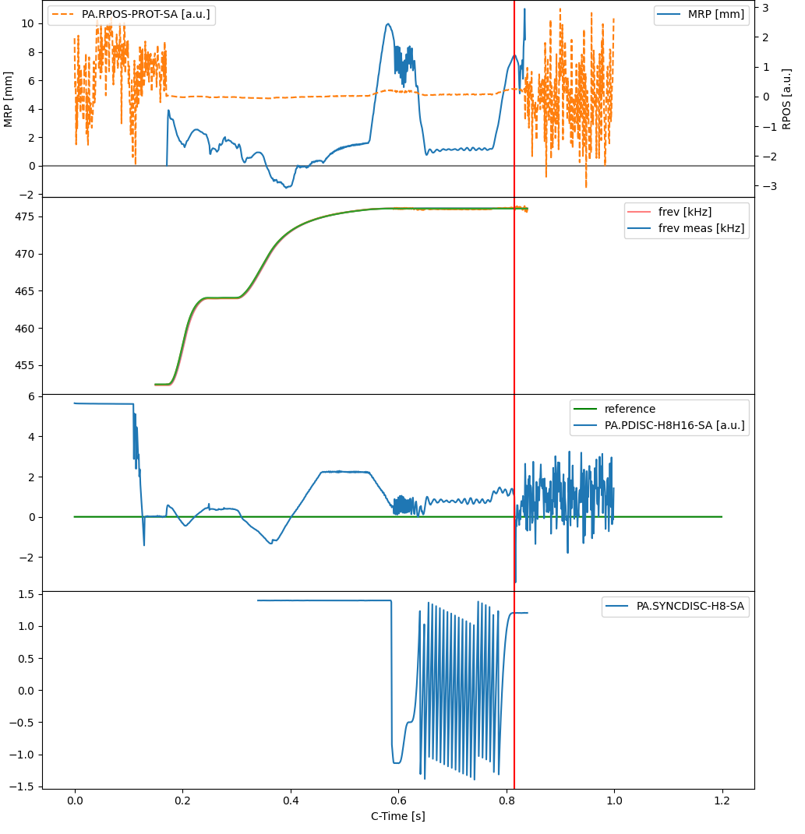
Applying the recipe: Global beam loops (LLRF)
Many signals with potential for analysis
Inputs for global beam loops such as the phase loop, radial loop, extraction resynchronization, f_{rev}
More challenging than voltages: less clear/no setting, normal and anomalous signals can be difficult to distinguish
For this presentation focus on phase loop signal!
Notes:
Before: single RF approach: move to include global beam control loops in anomaly detection scheme

Slide 14
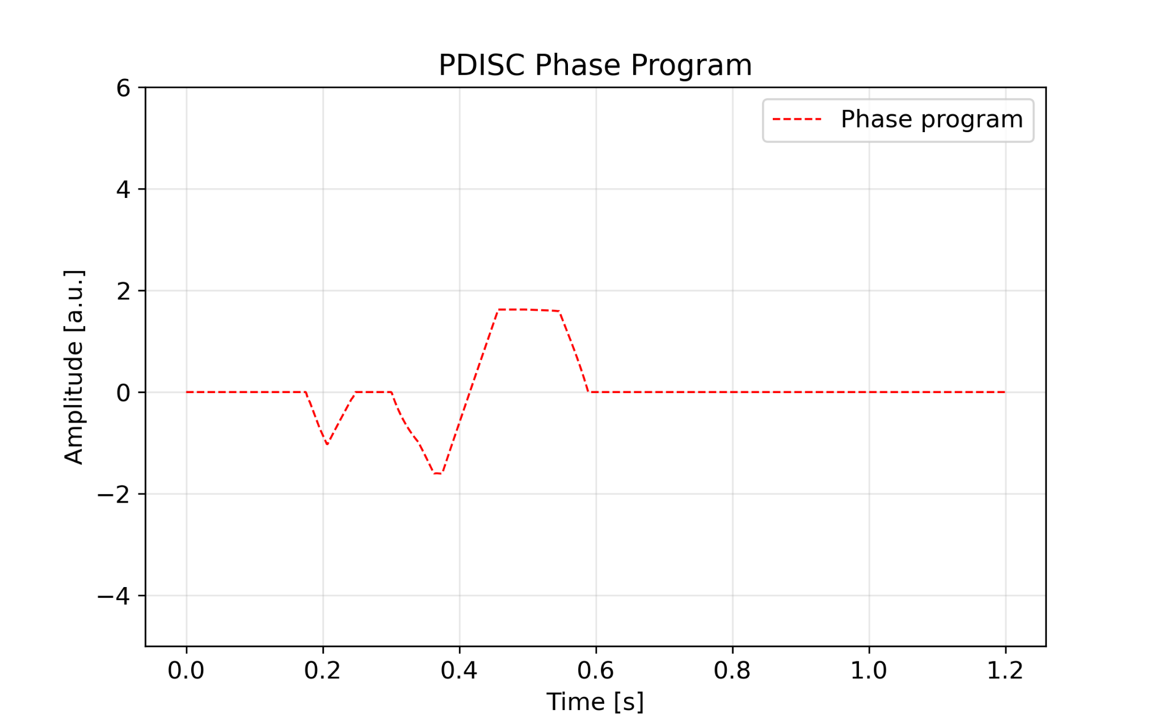
Constructing the phase loop dataset
Same approach as for rf voltages:
Collect unsupervised dataset:
Phase program (closest to setting)
Notes:
Single plot, same approach as RF voltages. Apply “blindly” to pdisc

Slide 15
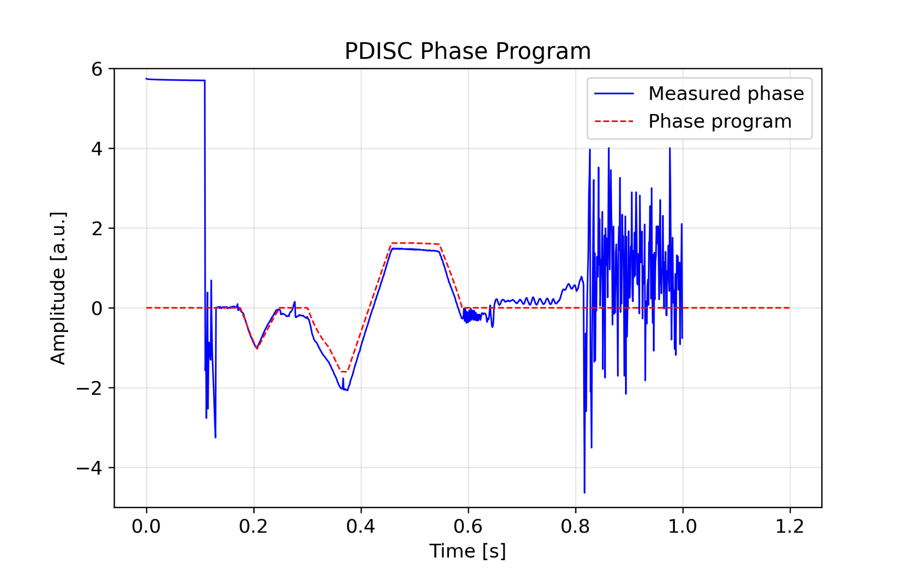
Constructing the phase loop dataset
Model input: Measured signal and matched (inverted and scaled) phase program
Same approach as for rf voltages
Collect unsupervised dataset:
Phase program (closest to setting)
Measured phase
Data cleaning less straightforward…
Signal and setting differ significantly: max difference checks not enough…
Notes:
Single plot, same approach as RF voltages. Apply “blindly” to pdisc

Slide 16

Constructing the phase loop dataset
Model input: Measured signal and matched (inverted and scaled) phase program
Same approach as for rf voltages:
Collect unsupervised dataset:
Phase program (closest to setting)
Transition crossing
Open loop handover
Measured phase
Injection
Data cleaning less straightforward…
Signal and setting differ significantly: max difference checks not enough…
Specialized checks required (with specific beam information, timings, etc.)
Extraction
More complex workflow →initial focus limited to single beam type: Multi-Turn Extraction (MTE) + smaller dataset (~6k)
Check for discontinuities at injection, transition, excessive noise after open loop handover → avoiding anomalies in training set.
Only train on data of interest: ~from injection to extraction
Notes:
Single plot, same approach as RF voltages. Apply “blindly” to pdisc

Slide 17
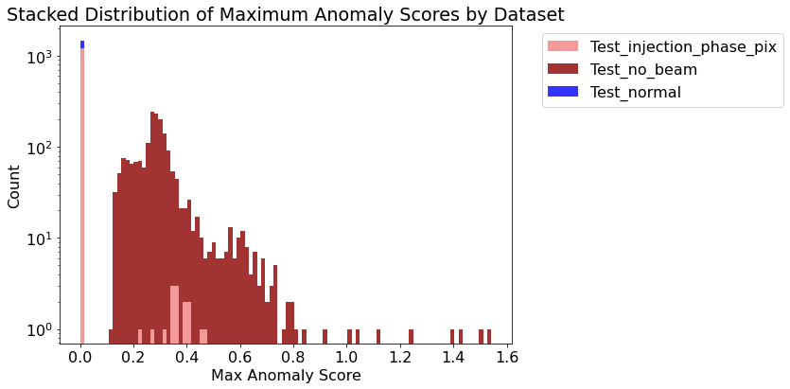
Autoencoder approach: Phase loop test results
Re-used model architecture from cavity voltages*
Reconstructs normal samples well, (some) anomalies poorly!
With thresholding can detect “easier” anomalies, e.g., “no beam”.
threshold
Struggles to differentiate certain anomalies
Overlap between normal samples, and injection phase offset samples…
Still useful to track large changes!
Could complementary methods allow differentiating these anomalies?
1d-convolutional neural network, see backup slides*

Slide 18
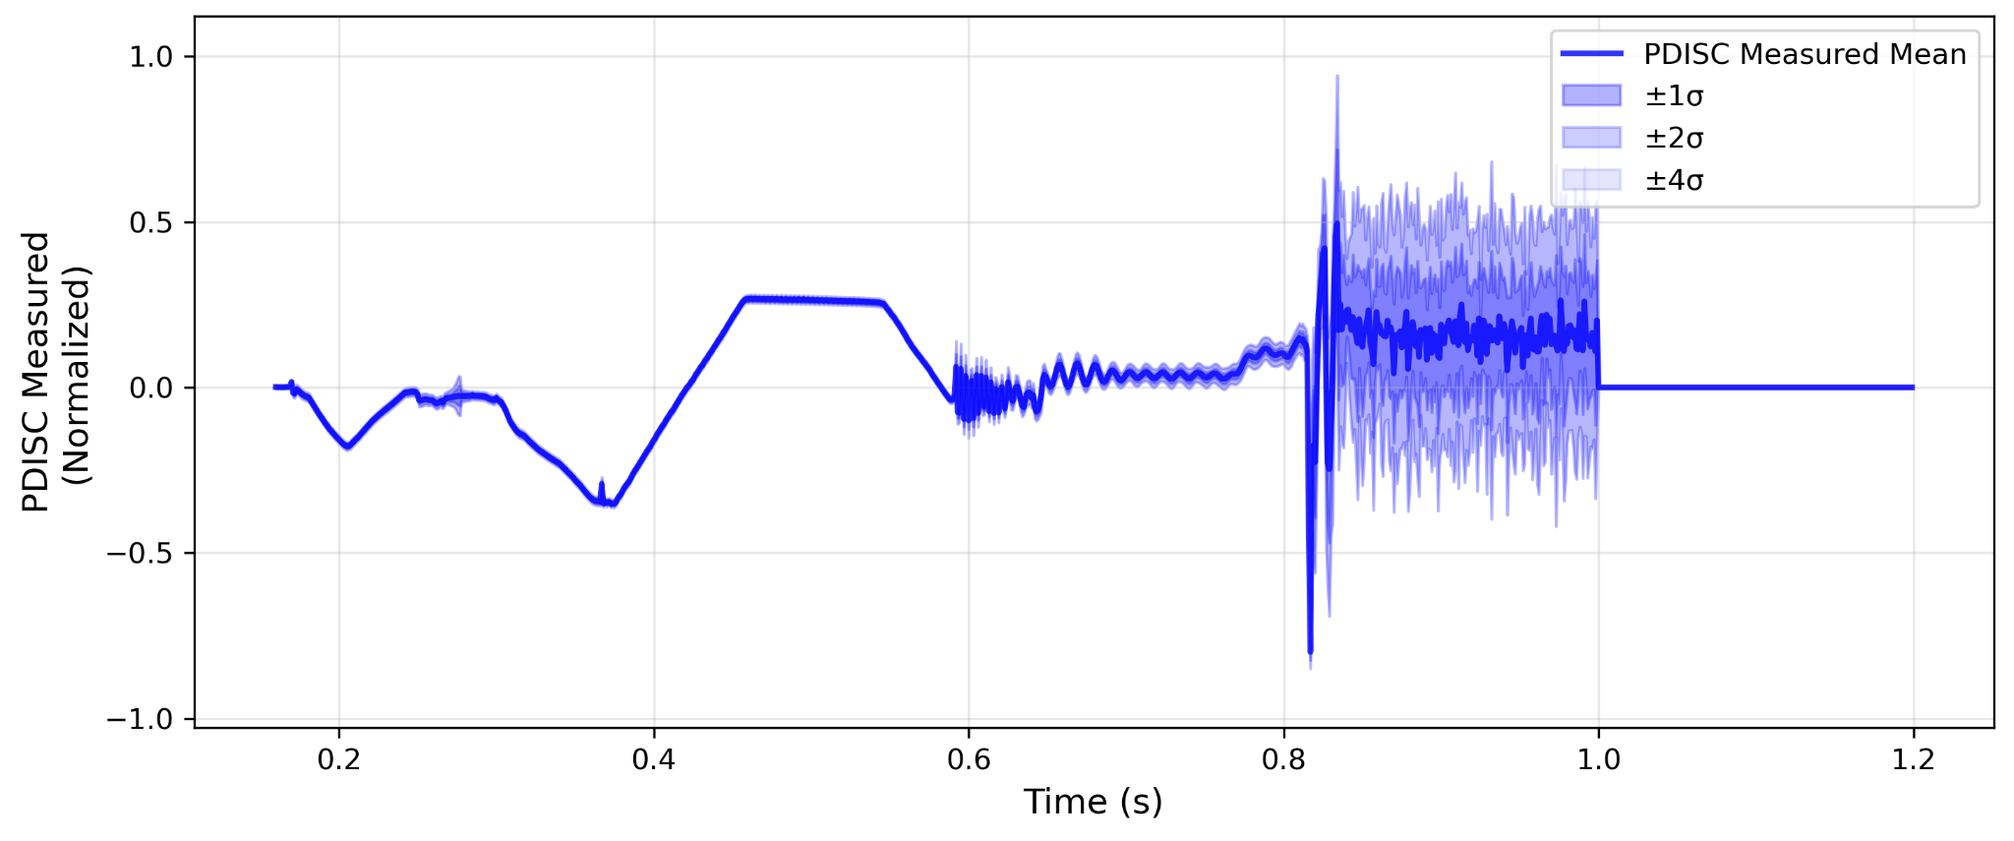
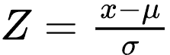
Complementing the autoencoder: Statistical models
Idea: Can a purely statistical model distinguish between the known classes?
Within valid regions (e.g., beam injection/extraction):
Model timesteps of signal as Gaussian: Calculating the 𝜇 and 𝜎 from the training set → Statistical expectation for value of signal at each timestep
Calculate Z-score* of test-points as anomaly indicator:
distance from mean in 𝜎*
Phase loop measurement model for MTE beam

Slide 19
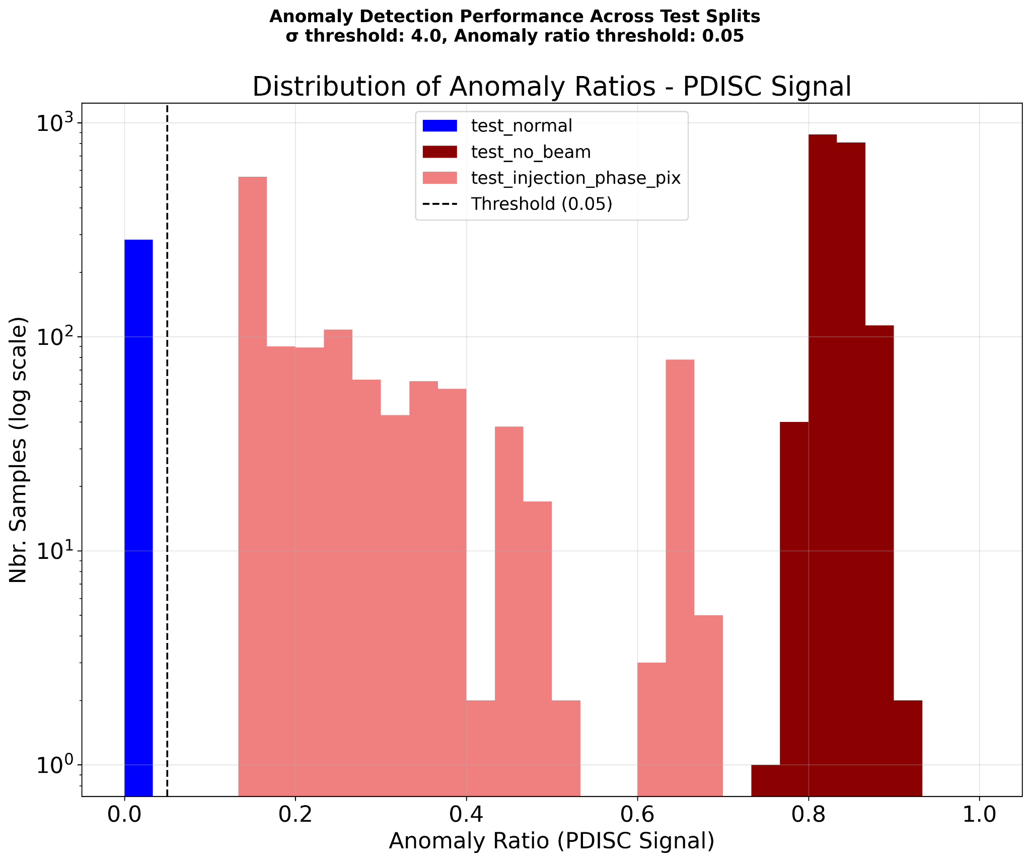
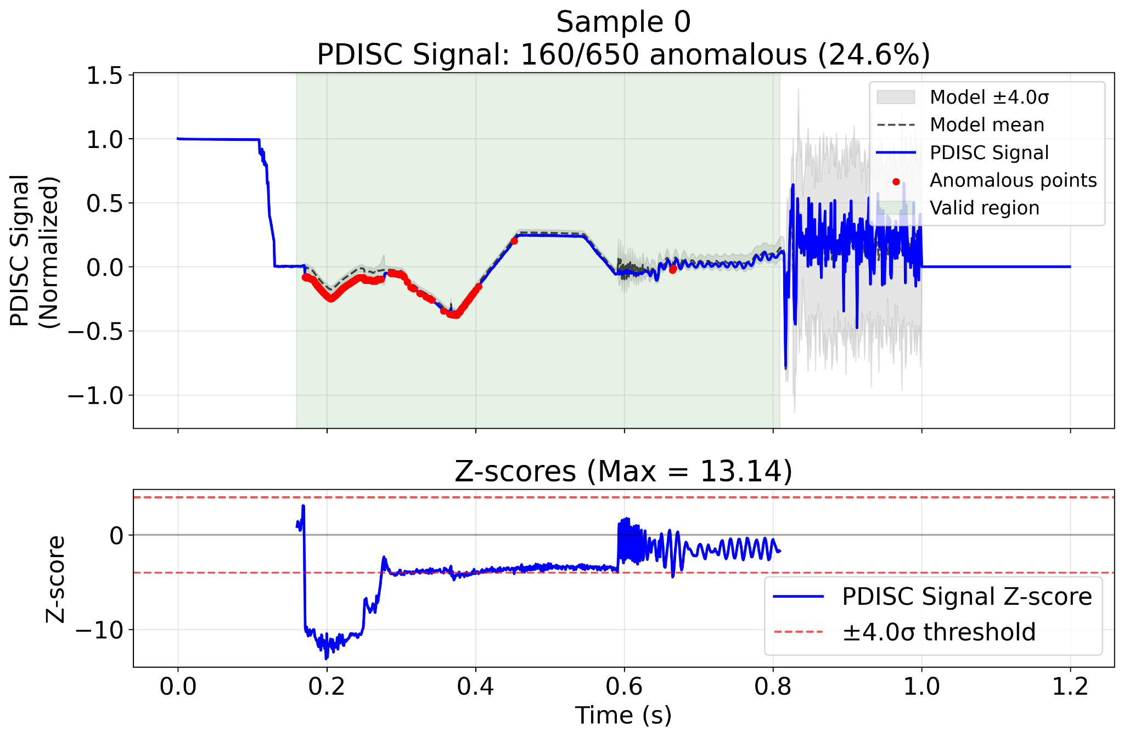
Statistical model: results for MTE
Model differentiates normal from known anomalies!
Anomalous point (A.P.) here ±4𝜎 from mean, cycle is anomalous if >5% A.P. Perfect distinction of known anomalies*,
Data split | Normal | No beam | injection phase
Nbr. datapoints | 284 | 1843 | 1216
Nbr. Anomalies | 0 | 1843 | 1216
Accuracy | 100% | 100% | 100%
→ Including injection phase:
Offset!
*with limited dataset and anomaly checks

Slide 20
Summary
Anomaly detection auto-encoders demonstrated and working for PS RF 10 MHz cavities at CERN.
Live web-based monitoring available and shared with equipment experts.
Further exploration planned towards preventative maintenance strategies,
→ can broken hardware be spotted in degraded performance before failure?
Naive extension to more RF subsystems effective for “obvious” anomalies.
More subtle anomaly types remain challenging…
→ Statistical methods provide complementary approach.
Data collection and cleaning crucial for success
If clear settings/references are available → relatively simple!
For other cases (such as beam loops): requires focused effort and beam knowledge.
Future work: Deploy anomaly detection models for as many RF signals as possible.
→ Correlate anomalies with: eachother, faults/hardware repairs, and beam degradations,
→ Working towards true end goal: automatically identify root-causes!
Notes:
Try to relate to generic conclusions, connect with
Focus on quick conclusions: Working solution for 10 MHz cavity voltage: Effective anomaly detection for multiple voltage programs and beam types with single model
Naive extension to subsystems effective for large anomalies → Further refinement needed for specific types, statistical methods provide complementary approach
Generally, most cumbersome part of workflow is data collection and cleaning: If both settings and measurement are easily available → good performance is likely!
Towards the future: Streamline data collection, training, and deployment workflow → Deploy anomaly detectors for as many RF signals as possible
Exploit data for end-goal: correlating co-anomalies, and classifying root-causes.

Slide 21
Thank you for listening! Questions?

Slide 22
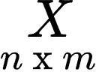
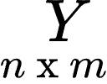
Reconstruction based AD: Auto Encoders
→ Architecture
Feature extraction
Reconstruction
Fully convolutional (1D conv.)
Handles varying cycle length natively
Correlates time-aligned signals easily
Modifiable to only reconstruct partial inputs X
More sophisticated options to be explored:
e.g., VAE, CVAE, Transformer based.
Downsampling
Upsampling
Feature extraction
Feature processing
ReLU
ReLU
Conv1D
Conv1D
ReLU
ReLU
Conv1D (stride = 2)
ConvTranspose1D (stride = 2)
ReLU
Conv1D
ReLU
Conv1D
16 x 8
8 x 16
32 x 16
16 x 32
n x 32
32 x n

Slide 23
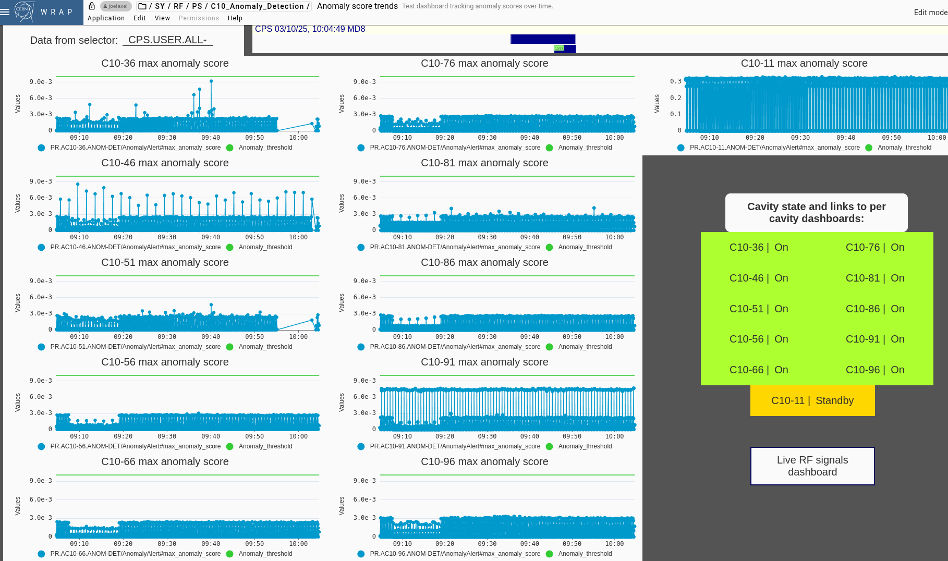
Live monitoring panel: Main overview
Selectable beam user (selector)
Cavity specific panel links/status
Anomaly threshold per cavity
Max anomaly score per cavity
Live signal monitoring panel link (see anomaly score, cavity voltage, LLRF)

Slide 24
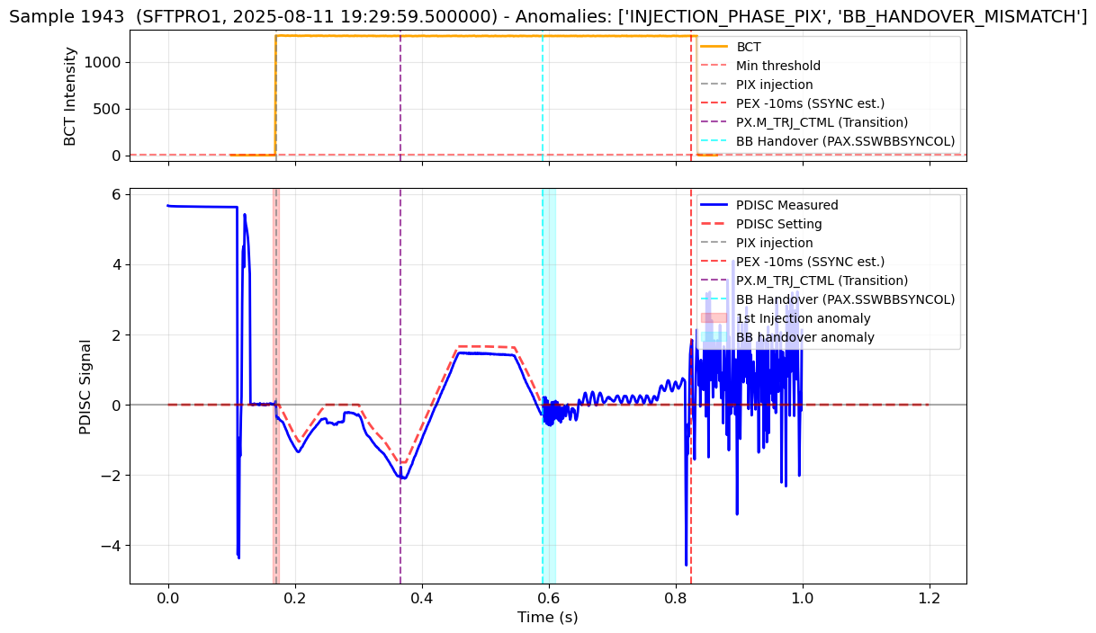
Example of filtered sample (MTE beam)
Offset at injection
Noisy signal after beam control handover

Slide 25
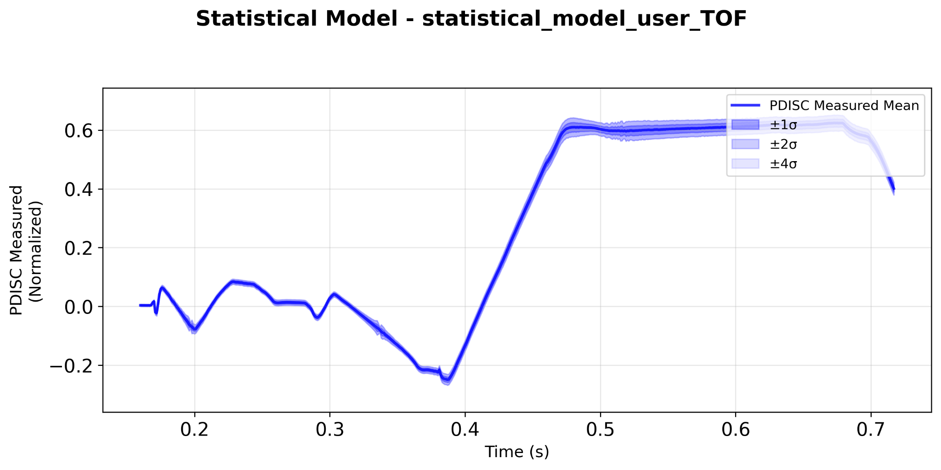
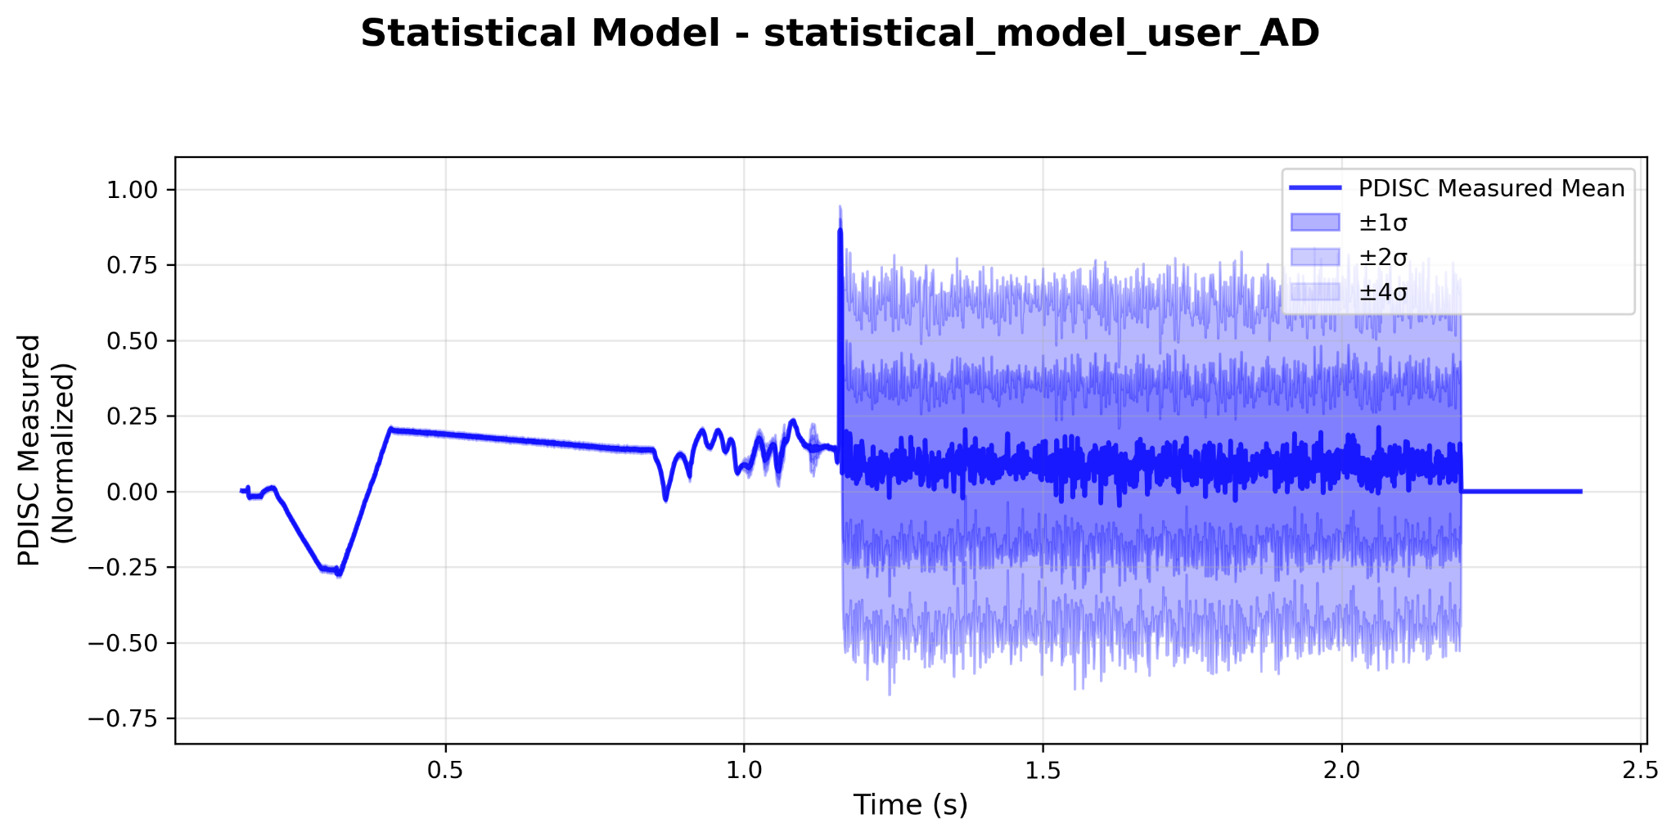
Statistical models for other beam types
Statistical models are bespoke for each beam type, however…
With data-cleaning workflows, can be (semi)-automatically generated:
→ Demonstrated by creating models for more beam types, e.g.: Time-of-Flight (TOF) experiment, and Antiproton-Decelerator (AD)
Statistical model: TOF
Statistical model: AD

Slide 26
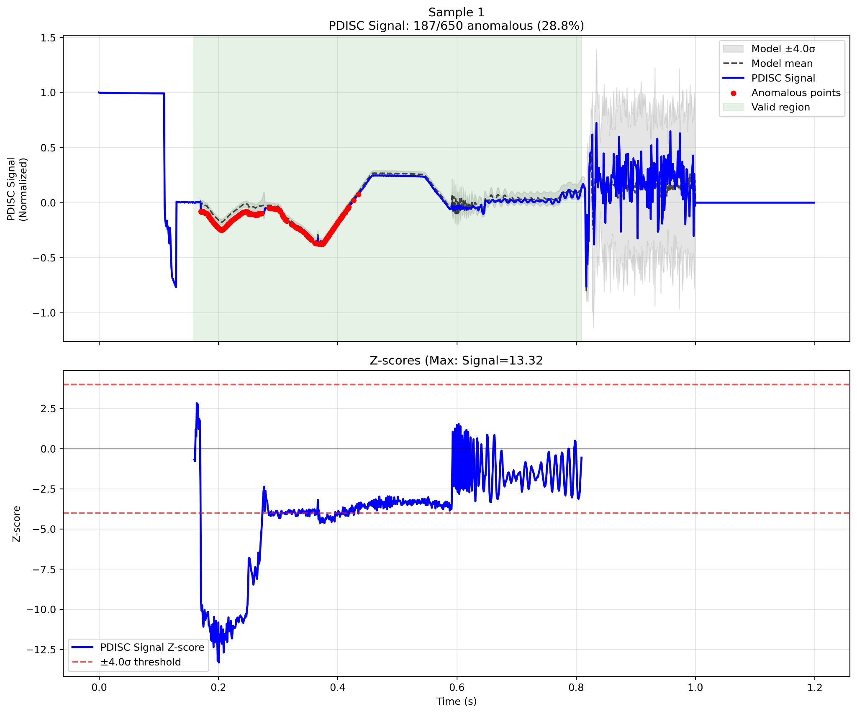
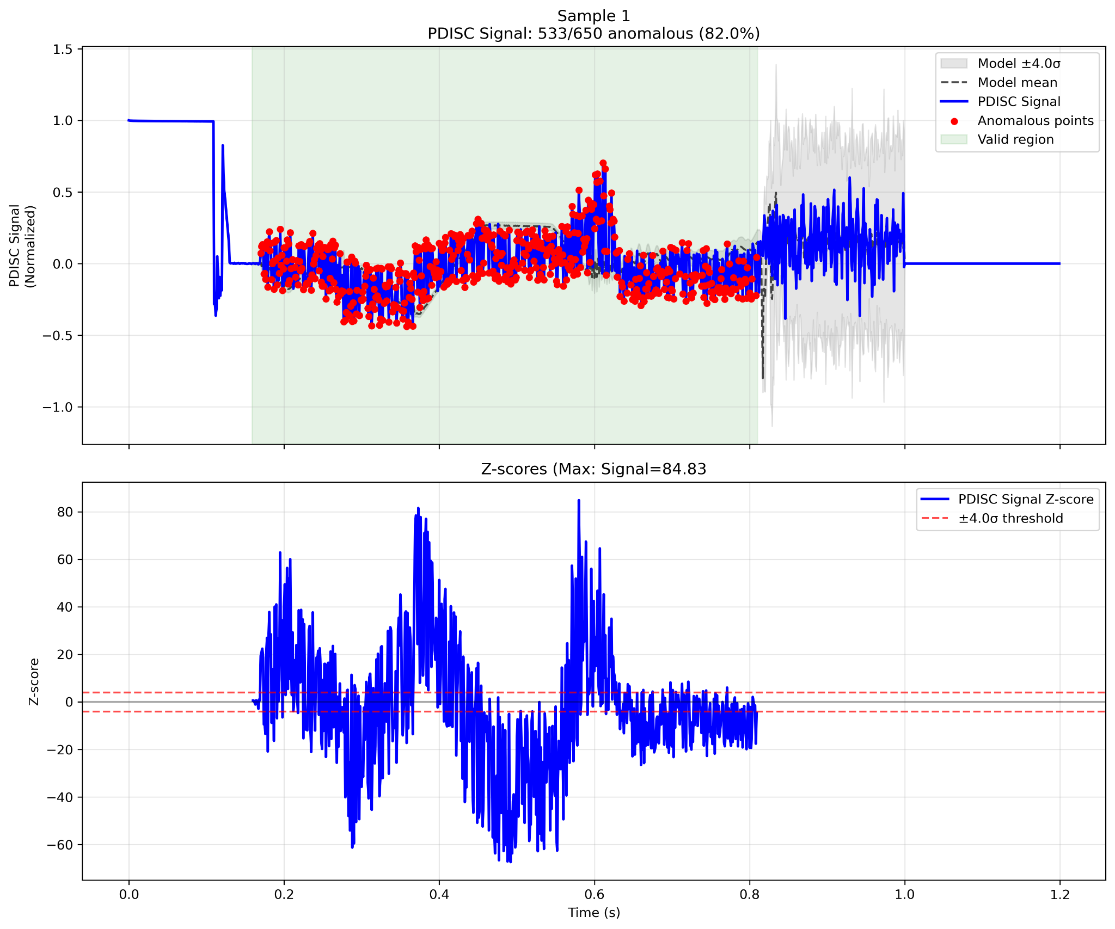
Extra plots: SFTPRO1 (MTE) anomalous samples
No beam
Injection phase

Slide 27
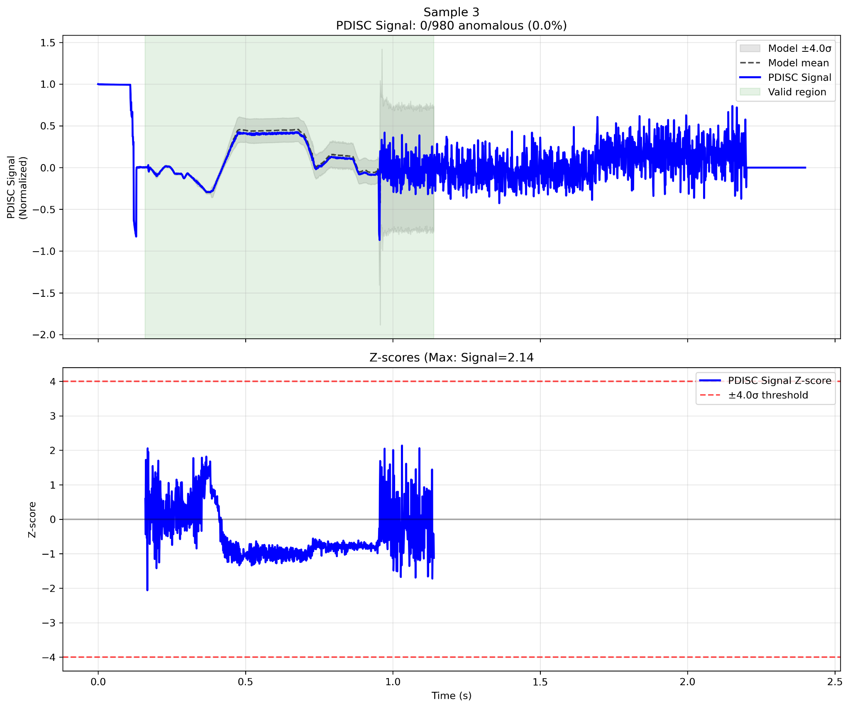
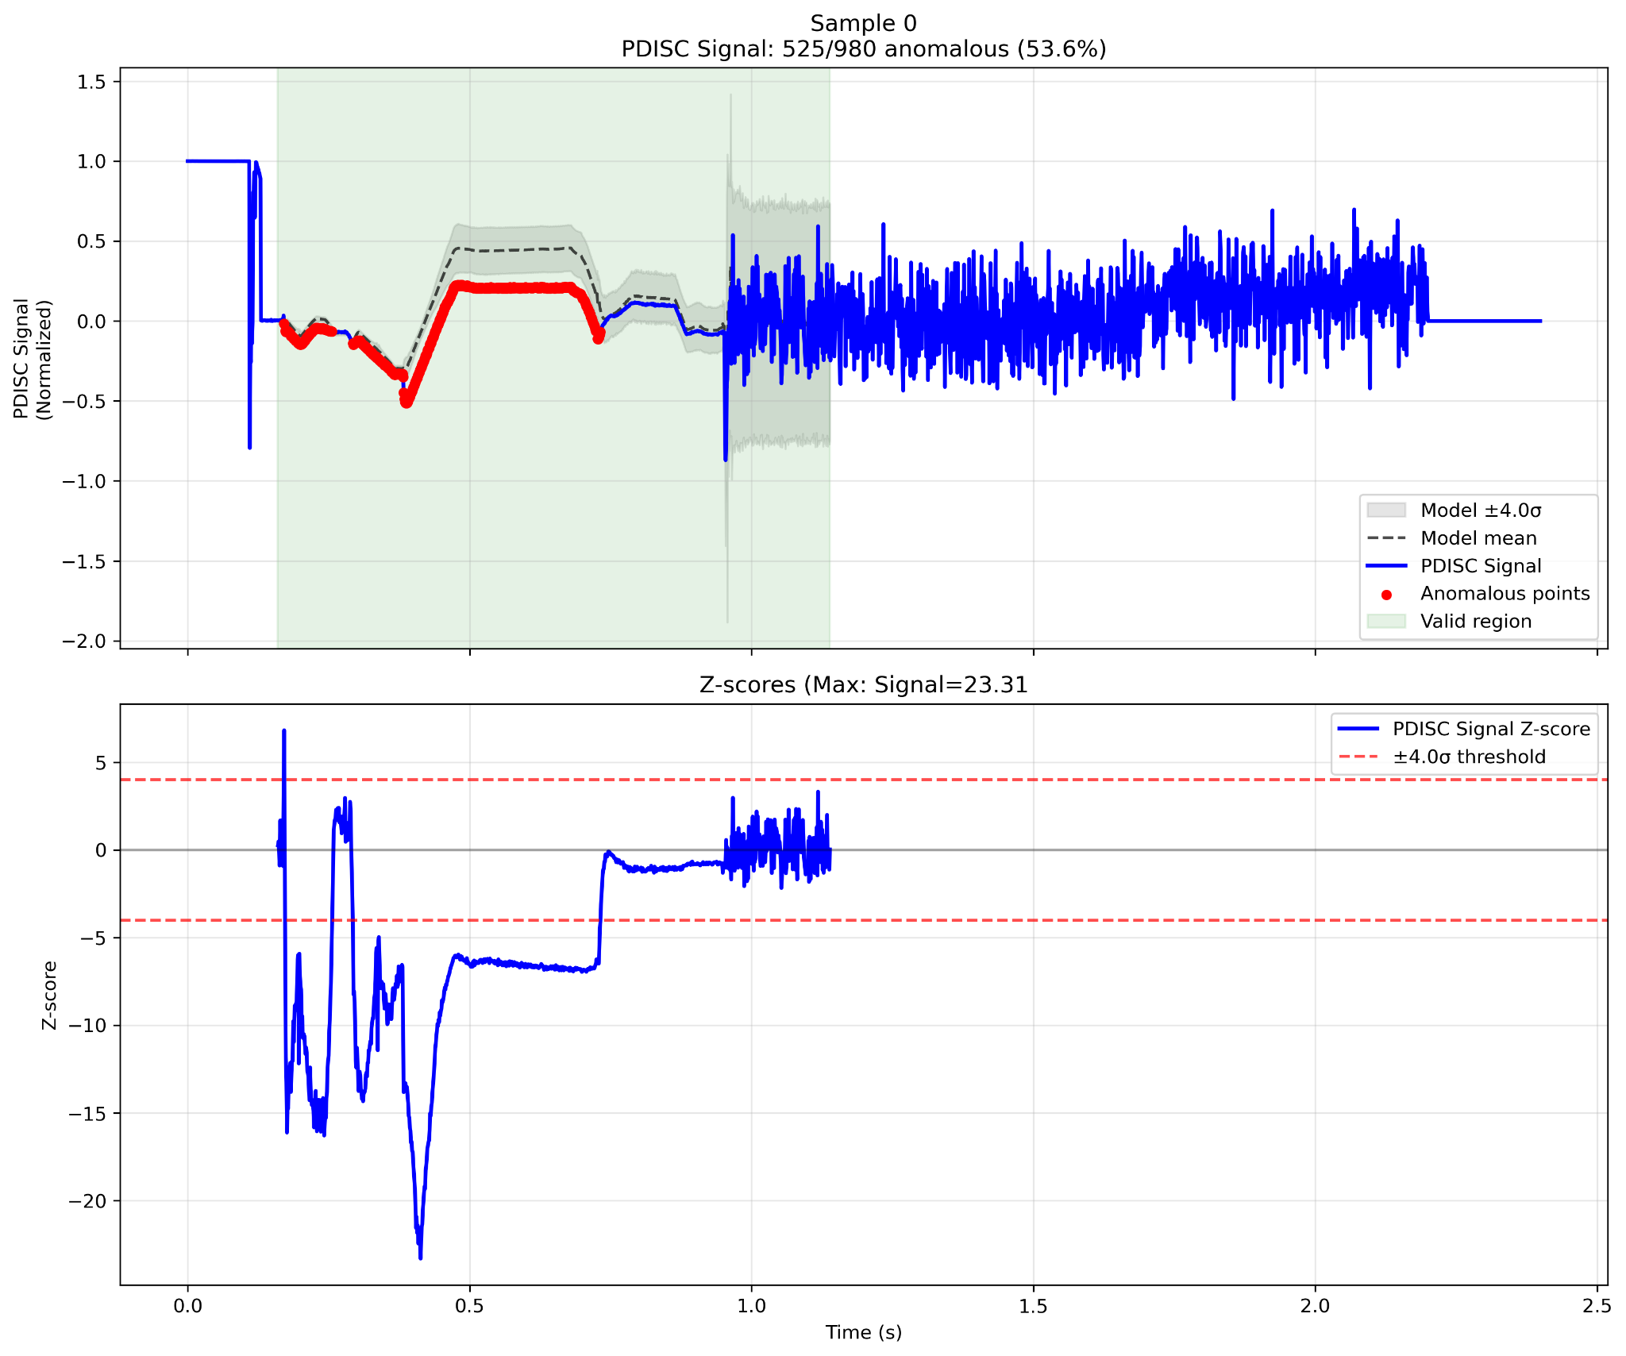
Extra plots: EAST1, normal and anomalous sample
Normal
Transition spread

Slide 28
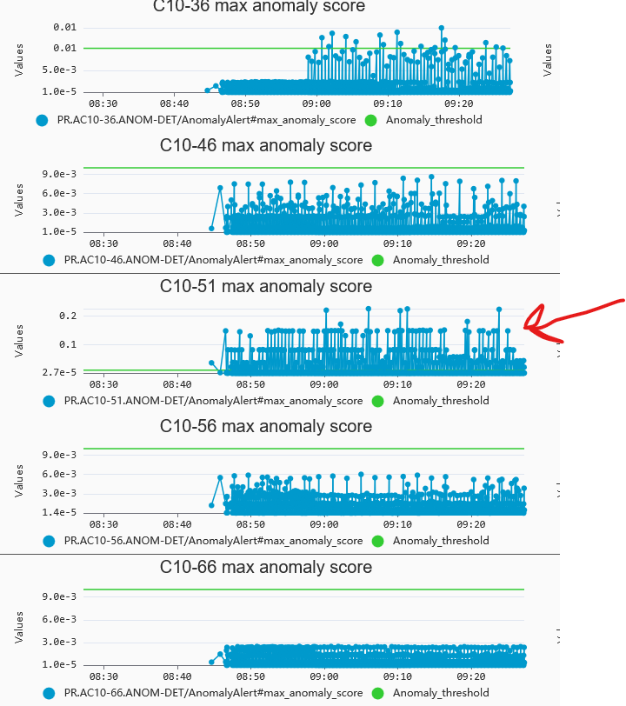
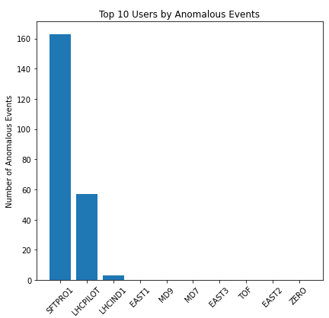
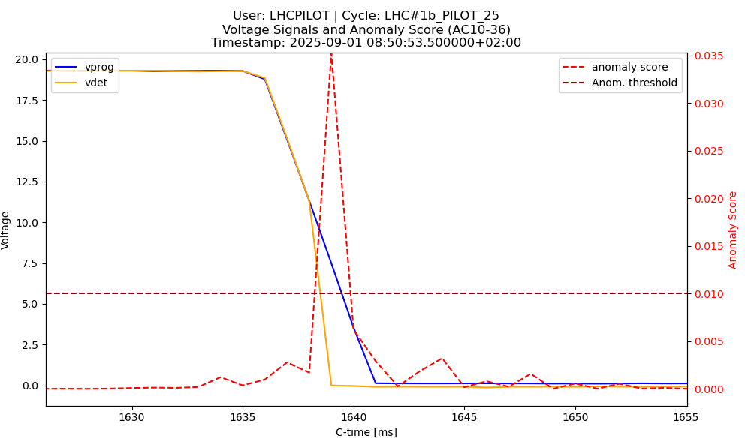
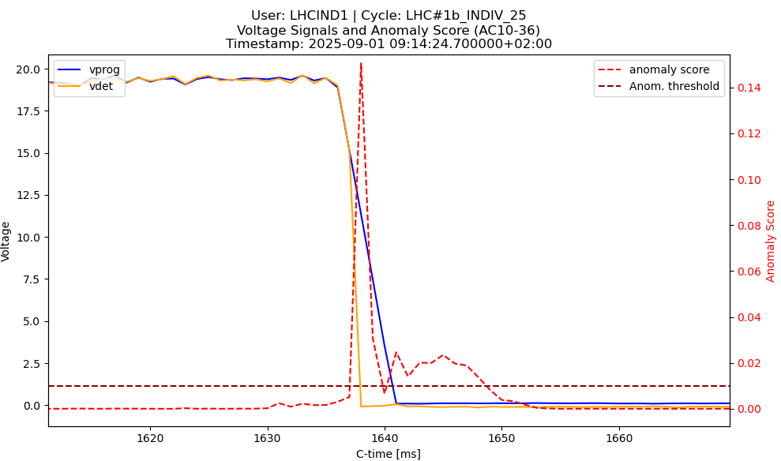
Example of settings correction:
C10-51 on SFTPRO1
3. Check of anomaly score and signals
C10-51 was consistently anomalous on monitoring
2. Most events came from SFTPRO1/LHCPILOT/LHCIND1 (checked through NXCALS, could be done on monitoring)
Early voltage drop
→ Gap relay closing early
→ HLRF expert informed and fix issue

Slide 29
Current WRAP (live monitoring) panels
Monitoring cavity anomalies (accessible only through CERN tunnel)
Main overview panel: https://wrap.cern.ch/app/196304
Shows all users and all cavities by default
Per cavity/selector overview: https://wrap.cern.ch/app/196944
Shows all operational USERS for a certain cavity. Can specify cavity by clicking on the device
MD USERS version: https://wrap.cern.ch/app/197536
Per cavity/USER live RF signals dashboard: https://wrap.cern.ch/app/197085
Shows live RF signals for a certain USER/Cavity. Both USER and cavity can be configured in the panel by clicking and choosing, or changing in the link.

Slide 30
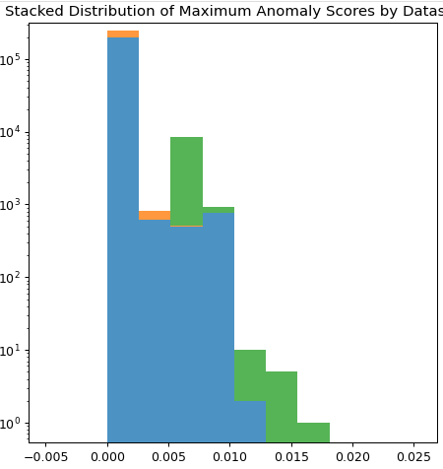
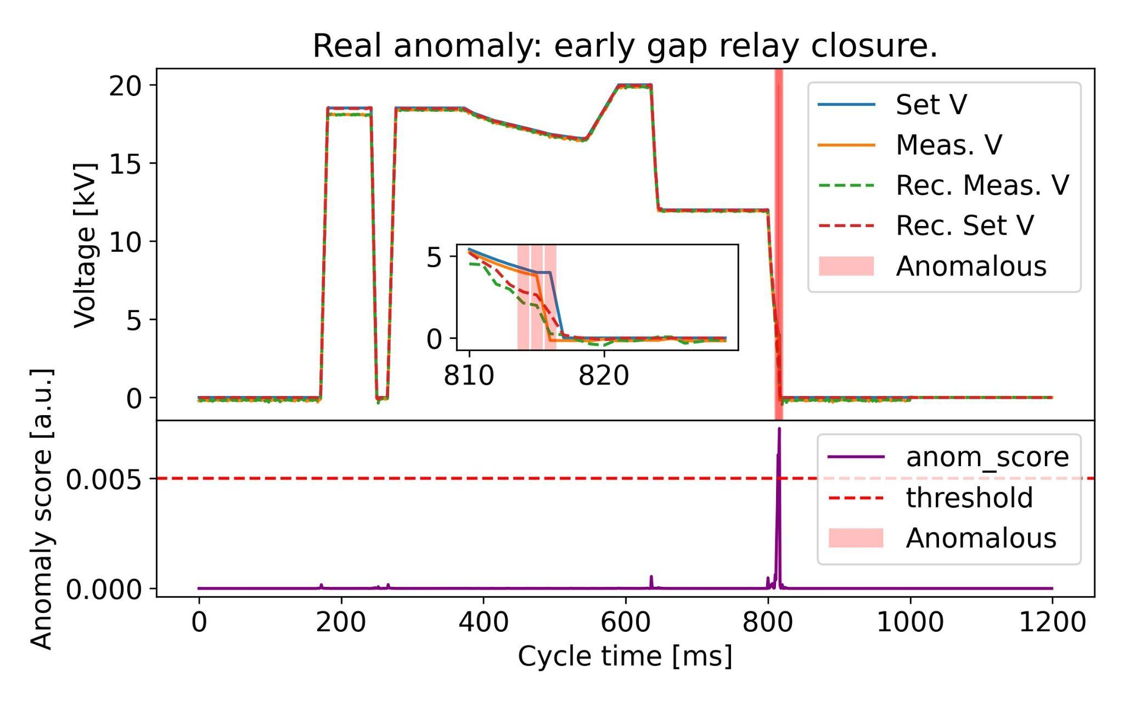
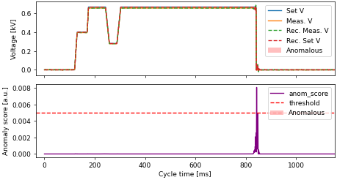
Training/Test results for 10MHz: Overlap at low a.s.
Test set examples with max anomaly score >0.005:
Generally real, minor anomalies
→ Should remain anomalies
Train set examples with max anomaly score >0.005:
98+% from single LSA cycle: EAST_15GeV_24
→ Outlier, to be investigated further
Initial anomaly threshold set to 0.005, but adjustable per cycle if needed.
→ Re-evaluate on more data
Fast voltage change not reconstructed well: suspected model limitation or lack of representation in training set…
EAST_15GeV_24

Slide 31
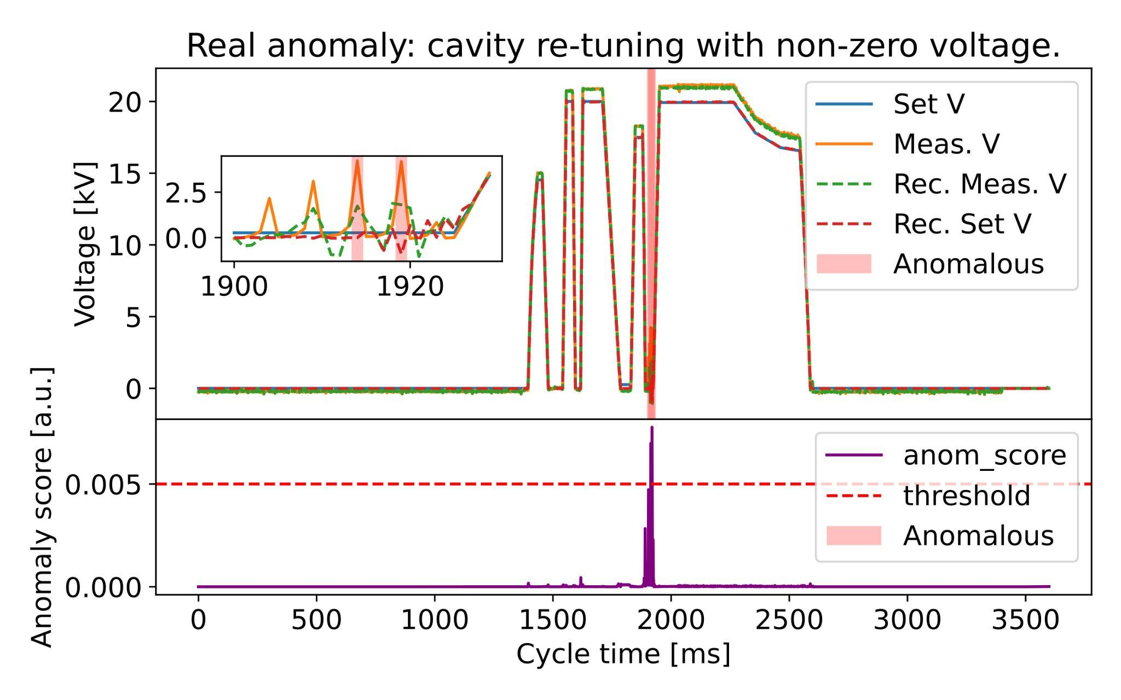
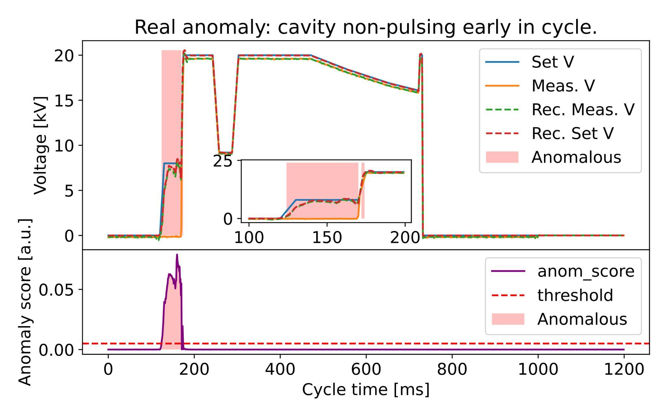
Training/Test results: Rediscovers anomalies
Detected anomalies: 10 MHz RF cavities
Several interesting cases re-discovered by autoencoder:
From Test set
From Training set
→ Should be excluded in future trainings
From Test set

Slide 32
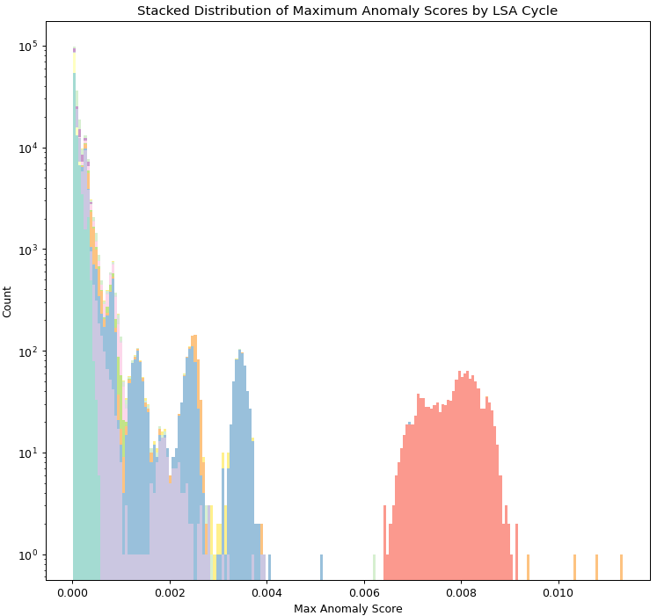
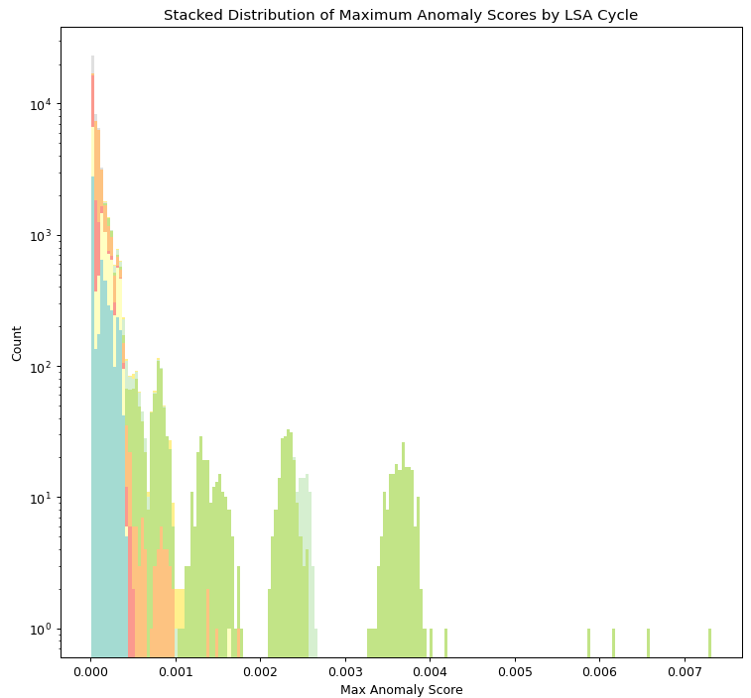
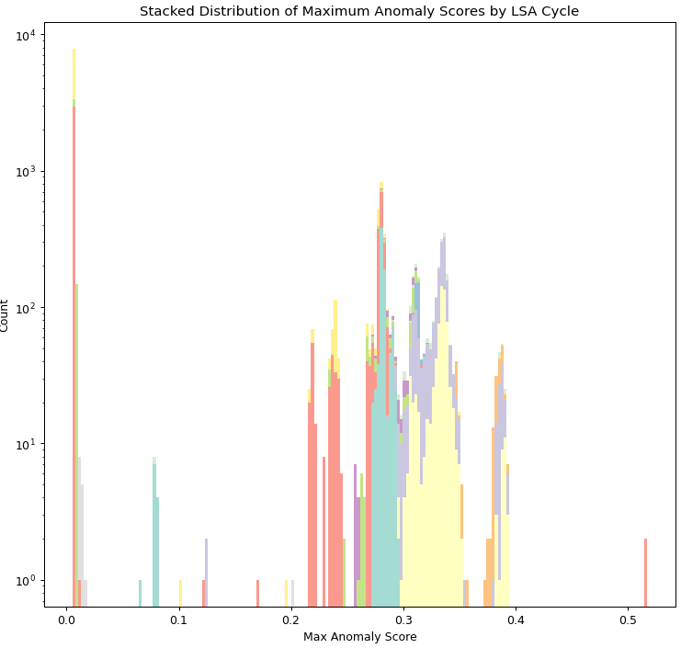
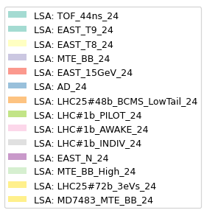
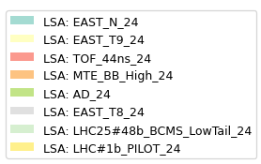
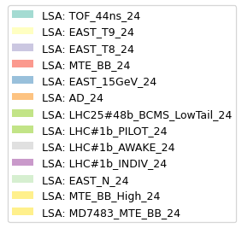
Extra: Max anomaly score histograms for train/test/val
Validation set
Suspected anomalies (test)
Training set
Good reconstruction
Majority of poor recon. come frome single cycle: EAST_15GeV_24

